Slide 1
MGMT 6057 contemporary business management
Module 9: accounting and financial information

Slide 2
Agenda
Managerial accounting vs. financial accounting vs. bookkeeping
Three key financial statements:
Balance Sheet
Income Statement
Statement of Cash Flow
Cash flow forecast
Break-even analysis
Financial statement analysis
Relevance for project managers and business owners

Slide 3

What is accounting?
Accounting is the process of recording, analyzing, and interpreting economic activities of a business
Businesses use this information for decision-making, planning (budgeting), taxation, financial statements, annual reports (for corporations)
Notes:
https://www.serviceseeking.com.au/blog/wp-content/uploads/2016/08/accounting-3.jpg

Slide 4
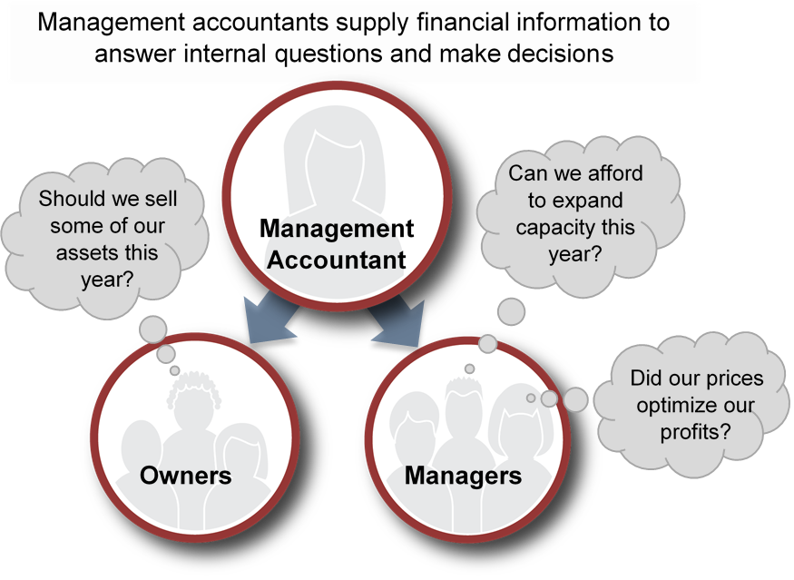
Managerial accounting
video
Notes:
Figure CC BY 4.0. Retrieved from: https://commons.wikimedia.org/wiki/Category:Figures_from_Fundamentals_of_Business_by_Skripak

Slide 5
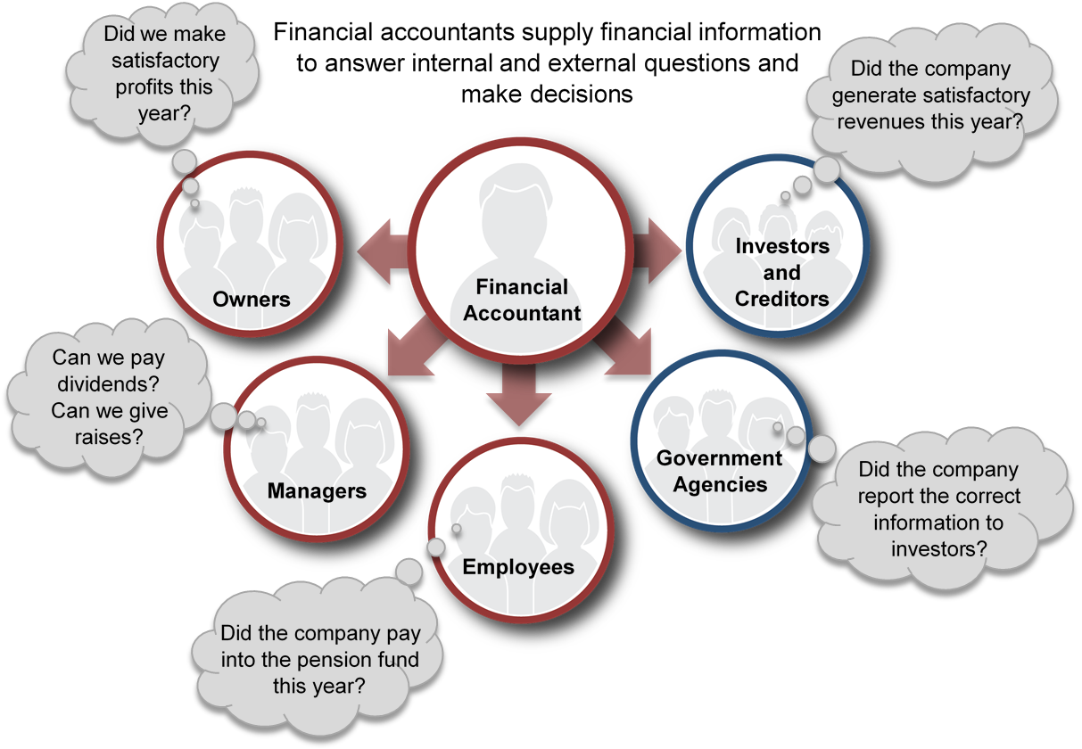
Financial accounting
Notes:
Photo CC BY 4.0. Retrieved from: https://commons.wikimedia.org/wiki/Category:Figures_from_Fundamentals_of_Business_by_Skripak

Slide 6

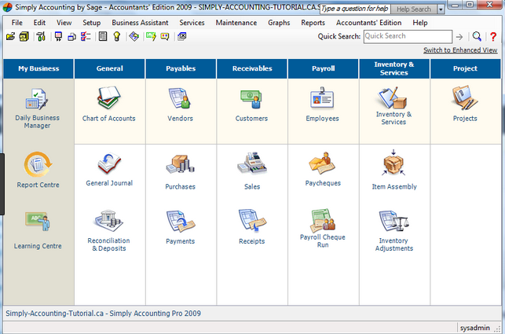
bookkeeping
Recording day-to-day financial transactions in an organized and consistent manner (usually electronic)
Cash purchases and sales
Returns
Payroll
Bank deposits
Payables (paying invoices from suppliers)
Receivables (sending invoices to customers)
Preparing summary reports
Forwarding summarized data to accountant for analysis and preparation of financial statements
Notes:
Image: https://keydifferences.com/wp-content/uploads/2018/01/manual-vs-computerised-accounting.jpg
http://www.simply-accounting-tutorial.ca/wp-content/uploads/2010/09/simplyaccountinghomescreen.png

Slide 7
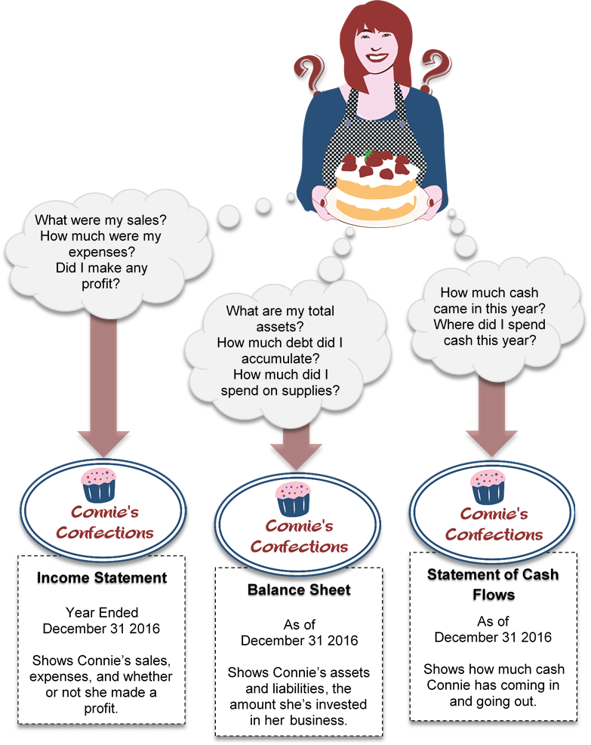
Three key financial accounting statements
Notes:
Photo CC BY 4.0. Retrieved from: https://commons.wikimedia.org/wiki/Category:Figures_from_Fundamentals_of_Business_by_Skripak

Slide 8

Income statement
Also known as Profit and Loss (P&L) Statement
Did the firm make a profit?
Represents activity over a period of time
Monthly
Quarterly
Six-Months
Fiscal Year (12 consecutive months)
Revenues minus expenses
video
Notes:
Image: http://insuranceblog.accenture.com/wp-content/uploads/2017/12/Income_Statement.jpg

Slide 9
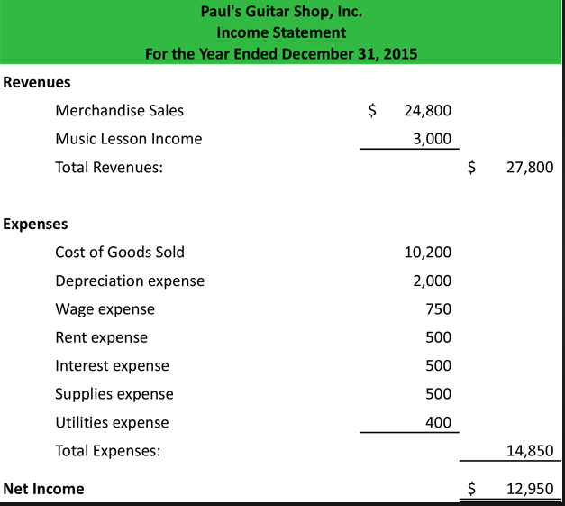
Notes:
Image: http://www.myaccountingcourse.com/financial-statements/images/income-statement-example.jpg
Note: all of these terms are self-explanatory, except depreciation expense
Depreciation: when you buy assets such as vehicles, their value decreases over time (which is why a used car is much cheaper than a new car). The government allows you to “write off” a portion of the asset’s original cost each year, to represent depreciation. The government specifies what percentage is depreciated from different types of assets. Depreciation expense is the allowable depreciation deduction for the time period indicated at the top of the Income Statement.
Accumulated depreciation: when you buy assets such as vehicles, their value decreases over time (which is why a used car is much cheaper than a new car); accumulated depreciation represents the loss in value of certain assets (e.g., cars, computers) over time since the asset was acquired.

Slide 10
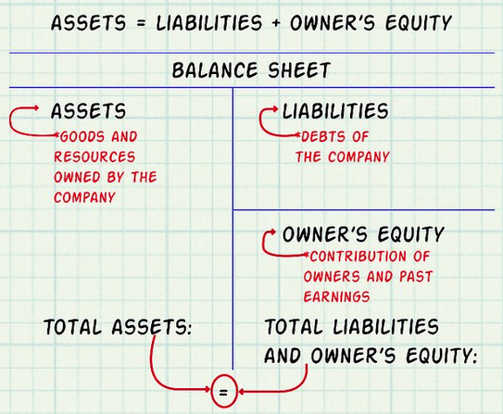
Balance sheet
Shows the value of firm on a given date (not over a period of time)
Assets: what a firm owns
Current and fixed assets (examples?)
Liabilities: what a firm owes
Short term and long term liabilities (examples?)
Equity: owners’ investment and retained earnings from prior years
“Fundamental accounting equation”
Assets = Liabilities + Owners’ Equity
or
Owners’ Equity = Assets - Liabilities
Notes:
Image: https://www.google.com/url?sa=i&rct=j&q=&esrc=s&source=images&cd=&ved=2ahUKEwjByeno19DiAhUBsJ4KHRxICYEQjRx6BAgBEAU&url=https%3A%2F%2Fwww.wikihow.com%2FMake-a-Balance-Sheet-for-Accounting&psig=AOvVaw0mUFXNDrUJkLKupaddCt59&ust=1559767194272647
Current Asset: will be consumed within a year (e.g., office supplies)
Fixed Asset: e.g., truck, building
Short Term Liability: will be paid within a year (e.g., electricity invoice)
Long Term Liability: long term loans and mortgages (e.g., 5-year bank loan)
Balance sheet can be horizontal or vertical format

Slide 11
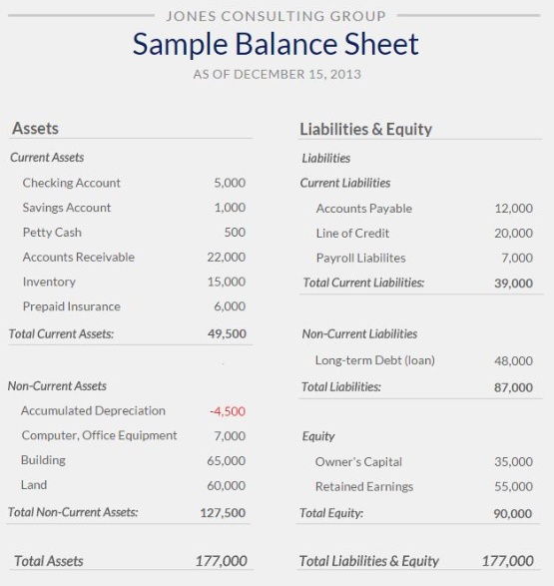
Balance sheets can be formatted on a side-by-side basis, or vertically (asset section on top, liabilities section in the middle, equity section on the bottom)
See slide notes below for explanation of terms…
Notes:
Source: https://s-media-cache-ak0.pinimg.com/736x/c0/07/87/c007874d944e867f5b9514d6afa7b863--accounting-training-accounting-and-finance.jpg
For exam purposes, you need to know:
what a balance sheet is,
the three main sections of a balance sheet (assets, liabilities, owner’s equity),
The difference between current and non-current (or fixed) assets, (with examples)
The difference between current and non-current (or long term liabilities) (with examples),
The difference between accounts receivable and accounts payable, and
how the three main sections relate to each other (fundamental accounting equation).
What are some of the terms used in the example balance sheet on this slide?
Checking and savings accounts: these are two different kinds of bank accounts (bank fees, interest earned on deposits, etc., differ for these accounts)
Petty cash: this is the small amount of actual cash that a business keeps on hand for miscellaneous expenses (e.g., buying coffee for the office kitchen)
Accounts receivable: money that customers owe you (you’ve issued invoices to them, they will pay it within days or months)
Inventory: the value of inventory
Prepaid insurance: typically, when you insure a business, home, or vehicle, you pre-pay for an entire year, or you make a payment at the beginning of each month to the insurance company. As the month or year passes, you ‘consume’ the service (i.e., insurance protection) that you’ve paid for
Accumulated depreciation: when you buy assets such as vehicles, their value decreases over time (which is why a used car is much cheaper than a new car); accumulated depreciation represents the loss in value of certain assets (e.g., cars, computers) over time
Accounts payable: money that you owe to other people or organizations (excluding banks or financial lenders); includes electricity invoices, internet invoices, etc. that you intend to pay within weeks or months
Line of Credit: this is similar to a credit card. With a credit card, there is a maximum amount of money that you can spend on a credit card (i.e., credit limit), but you don’t have to use the credit card if you don’t want to. When you do use it, you are charged interest if you don’t pay the outstanding balance in full by a deadline. A line of credit is provided by a bank. They will make funds available to you if needed, up to a certain limit. You pay interest on what you owe.
Payroll liabilities: Typically, workers get paid bi-weekly, bi-monthly, or monthly. When workers complete their daily work shifts, the company hasn’t paid them yet but they will when the next pay day arrives. Payroll liabilities typically consist of unpaid wages (which will be paid at the next pay day).
Long term debt: These are bank loans or mortgages (bank loans for property). When you borrow a specific amount, to be paid back by a specific date (or in specific installment payments), with interest, this is a loan.
Retained Earnings: These are profits from previous years that are set aside, to be used at some future point (e.g., when buying new machinery, paying to shareholders, developing new products, etc.).

Slide 12

Statement of cash flow
Summary of cash flow (in and out of the business) during a past time period
Contains three main sections:
Cash flow from Operations (e.g., sales revenue, paying suppliers)
Cash flow from Investing (e.g., purchasing or selling a building)
Cash flow from Financing (e.g., loans, dividends paid to corporation shareholders)
Notes:
Image: http://zabanacpa.com/wp-content/uploads/2016/05/Blog-5.jpg

Slide 13
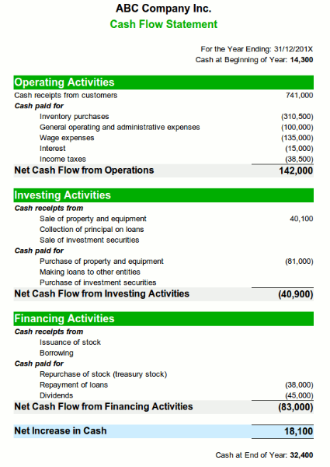
Assess performance of company:
Over the year, did ABC Company take in more cash than it spent?
Where is the main source of cash - Operations (e.g., sales)? Investing? Financing?
Notes:
Image: http://helpsme.com/sites/helpsme.com/files/images/article-images/example-cash-flow-statement.gif
Note: this example is a new company, since it has no cash at the beginning of the reporting period

Slide 14
Cash flow forecast
Estimate of cash coming into and out of the business during a future period (usually on a month-by-month basis)
Purposes (examples):
Will I have enough cash to pay for future expenses?
Will I need to obtain a bank loan? (If so, when?)
Is it worthwhile to purchase a large piece of equipment?

Slide 15
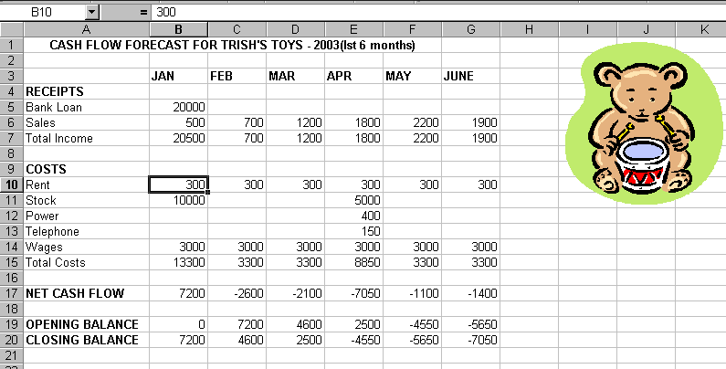
Cash flow forecast
Notes:
Source: https://maritalsettlements.com/wp-content/uploads/2017/02/cash-flow-forecast-cash_fllow_teddy.gif

Slide 16
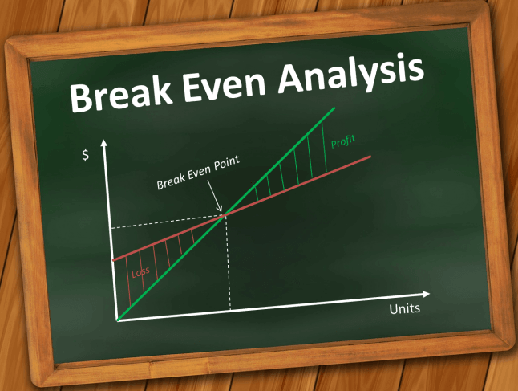
Break-even analysis
“How much do I have to sell to break even and recover my costs?”
Fixed costs
Do not change with number sold
E.g. rent, advertising, insurance
Variable costs
Depend upon number sold
E.g. material costs, shipping
Contribution margin
Gross profit on each sale

Slide 17

Break-even analysis
Calculate fixed costs
Calculate variable cost per unit
Calculate contribution margin per unit
= selling price per unit – variable cost per unit
Calculate break-even point in units
= fixed costs / contribution margin
5. Calculate break-even point in sales
= break-even point in units * selling price per unit
video
Notes:
Image: https://s3.amazonaws.com/pas-wordpress-media/content/uploads/2015/05/shutterstock_102144676-e1432076568898.jpg

Slide 18
Break-even analysis: example
You manufacture and sell toy airplanes. You want to know how many you need to sell in order to break even.
You pay workers $240 regardless of how much they make
You plan to spend $40 on advertising and need a $20 table to put the product together
The cost of materials for the airplanes is $5 each and are they are packaged in a box costing $1
The selling price is $10
What is the break-even point?

Slide 19
Break-even analysis: example solution
Determine total fixed costs:
Fixed costs = $240 salaries + $40 advertising + $20 table = $300
Identify variable costs on a per-unit basis:
Variable cost per unit = $6 ($1 for the box + $5 for plane materials)
Determine contribution margin per unit: selling price per unit – variable cost per unit:
Contribution margin = $10 selling price – $6 variable cost per unit = $4
Calculate break-even point in units: fixed costs ÷ contribution margin per unit:
Break-even units = $300 fixed costs ÷ $4 contribution margin per unit = 75 units
Calculate break-even point sales: break-even point in units * selling price
Breakeven in sales = 75 units * $10 selling price
= $750

Slide 20
Break Even Analysis question
A company makes a product with a selling priced of $20 per unit. The variable cost is $15 per unit.
If fixed costs are $10 000, what is the break-even point in units? In sales?

Slide 21

Financial statement analysis
How can we compare the performance of two different firms (with different firm sizes, different assets, etc.)?
How do we evaluate our firm’s financial performance over time?
Use ratio analysis:
Profitability ratios
Liquidity ratios
Debt ratios
Efficiency ratios
video
Notes:
Image: http://image.slidesharecdn.com/ratioanalysis-140514135724-phpapp01/95/ratio-analysis-1-638.jpg?cb=1400093892

Slide 22

Profitability ratios
Return on sales (ROS): Percent profit on each sale (also known as “net profit margin”), ideal varies by industry (video)
= Net income / sales * 100
Return on equity (ROE): Percent return on owners’ investment, 15%+ is good (video)
= Net income / owners’ equity * 100
Earnings per share (EPS): Profit that owners make on each share of stock (video)
= Net income / # shares of stock
Notes:
Image: https://i2.wp.com/shearwaterasia.com/wp-content/uploads/2017/03/Profit-Analysis-1-CM.png?fit=425,353

Slide 23

Liquidity ratios
Current ratio (working capital ratio)
Ability of firm to pay current bills
Current assets: assets turning into cash within a year (e.g., inventory)
Current liabilities: debts owed with a year (e.g., short-term loan)
Current ratio = current assets / current liabilities
video
Notes:
Image: https://tse1.mm.bing.net/th?id=OIP.73nxfm56rmW7esZc3ysqqQHaD1&pid=Api&P=0&w=334&h=174

Slide 24

Debt ratios
How great is the financial risk?
Debt ratio
How much of the firm is financed by borrowing? (.4 or lower is good) (video)
= Liabilities / Assets
Debt-to-equity ratio
Ratio of debt financing to equity financing (video)
= Liabilities / Owners’ equity
Notes:
Image: https://tse4.mm.bing.net/th?id=OIP.hQZR0WX2Z-VowbtjwKXobQHaHa&pid=Api&P=0&w=300&h=300

Slide 25

Efficiency ratios
Inventory turnover ratio
How many times in a period does the firm replace its inventory?
= Cost of Goods Sold / Inventory
Examples:
Walmart turnover (fiscal year end Jan 2021): 9.40
Apple turnover (fiscal year end Sept 2020): 41.52
Samsung Electronics turnover (fiscal year end Dec 2020): 5.07
Facebook turnover (fiscal year end Dec 2020): 0
Tiffany & Co. turnover (fiscal year end Jan 2019): 0.67
video
Why do you think the turnover ratios are so different for each of these example companies?
Notes:
Image: https://www.educba.com/academy/wp-content/uploads/2018/12/Inventory-Turnover-Ratio-Formula.jpg
https://www.gurufocus.com/term/InventoryTurnover/WMT/Inventory%252BTurnover/Walmart%2BInc
https://www.gurufocus.com/term/InventoryTurnover/ssnlf/Inventory-Turnover
https://www.gurufocus.com/term/InventoryTurnover/aapl/Inventory-Turnover
https://www.gurufocus.com/term/InventoryTurnover/fb/Inventory-Turnover
https://www.gurufocus.com/term/InventoryTurnover/MEX:TIF/Inventory-Turnover/Tiffany
“Inventory Turnover measures how fast the company turns over its inventory within a year. A higher inventory turnover means the company has light inventory. Therefore the company spends less money on storage, write downs, and obsolete inventory. If the inventory is too light, it may affect sales because the company may not have enough to meet demand.” (Source: https://www.gurufocus.com/term/InventoryTurnover/aapl/Inventory-Turnover/Apple%20Inc)
Why the difference between Apple and Samsung’s inventory turnover? “Apple’s inventory turnover is much quicker, likely driven by its efficient demand planning, its use of contract manufacturers and its streamlined product portfolio. Samsung on the other hand has a sizable manufacturing operation and offers a wide array of products and components, requiring larger sums of cash to be tied up in inventory.” (Source: https://www.forbes.com/sites/greatspeculations/2016/06/07/why-is-apples-cash-conversion-cycle-significantly-shorter-than-samsungs/#539013be58eb)

Slide 26
Comparing financial statements (Annually or Quarterly) - examples
Facebook
META Stock Price | Meta Platforms Inc. Stock Quote (U.S.: Nasdaq) | MarketWatch
Apple
https://www.marketwatch.com/investing/stock/aapl/financials
Samsung Electronics
005930 Stock Price | Samsung Electronics Co. Ltd. Stock Quote (S. Korea: KRX) | MarketWatch
Compare the financial statements of these companies using the ratios we learned!

Slide 27
Relevance for project managers and business owners
For project managers:
Business cases (used to justify the feasibility/need for a project) may contain financial information
Cash flow analysis may be relevant for planning and decision-making during a project
For business owners:
Understanding the financial health of your business is important for success
Break-even analysis gives indication of minimum revenues needed to cover costs
Financial statements important or required for tax, investors, government filing (e.g., corporations), etc.

